Slide 1
CS487-Introduction to competitive programming: A2SV
November, 2019

Slide 2
Team
5 2nd year
7 3rd year
15 4th year
27 students
Emre + Alazar
29 team members

Slide 3
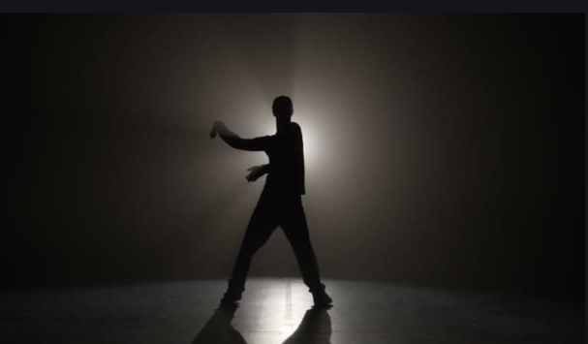
Objective
To get you to the level to succeed in job interviews with top Silicon Valley companies.

Slide 4
Materials
MIT Introduction to Algorithms
Stanford Design and Algorithms Part I
Stanford Design and Algorithms Part II
Stanford Design and Algorithms Part III
Interview Preparation Best Practices
Topcoder Tutorials

Slide 5
PROCEDURE FOR LECTURES
20% of the program
Me: Prepare the slides, present in the class, make it enjoyable
You: Focus and listen, ask questions when you don’t understand
Monday, Tuesday, Wednesday, Thursday: 4:30p - 5:30p
First part
Second part
Recap
20 mins
5 mins
20 mins
5 mins
10 mins
Break
Break

Slide 6
Labs
Monday, Tuesday, Wednesday, Thursday: 5:30p - 7:30p Friday: 4:30p - 6:30p
80% of the program
Me: Helping each of you individually
You:
Practicing by solving problems
Helping your peers when they get stuck
Using different platforms like Codeforces, Topcoder, Leetcode, etc.
6 contests

Slide 7
Q&A Sessions
With actively working people from Silicon Valley
Engineers, sales representatives, recruiters, business developers, product managers
Google, Facebook, Amazon, Square, Liftoff, etc.
We will decide on pre-request questions - 25 mins
Interview preparation, tactiques
Life in SV
Role definition
Day to day challenges
On the fly questions - 5 mins

Slide 8
Camp JAn 10 - JAn 30
We will decide on the dates
Optional
Camps are where the real magic happens (by experience)
All day problem solving
Contests

Slide 9
Questions???

Slide 10
Homework #1 - Environment setup
Create a Github profile
Create a Topcoder profile
Either login arena or download(requires JAVA)
Check out plugins, KawigiEdit is strongly recommended
Create a Codeforces profile
Create a Leetcode profile
Create a Codesignal profile
Update progress doc (class only)
Read about interview process, watch some videos, get excited!

Slide 11
Questions
What’s your biggest achievement in life so far?
Why do you want to intern at Silicon Valley?
Where do you want to see yourself in 10 years?
What kind of achievement would make you feel accomplished once you are 60 and look back?

Slide 12
Quote of the day
“Seek first to understand, then to be understood.” - 7 Habits of Highly Effective People

